Slide 1
Module A.2 Inside A PC
Karamvir Singh
Thursday October 4, 2018

Slide 2
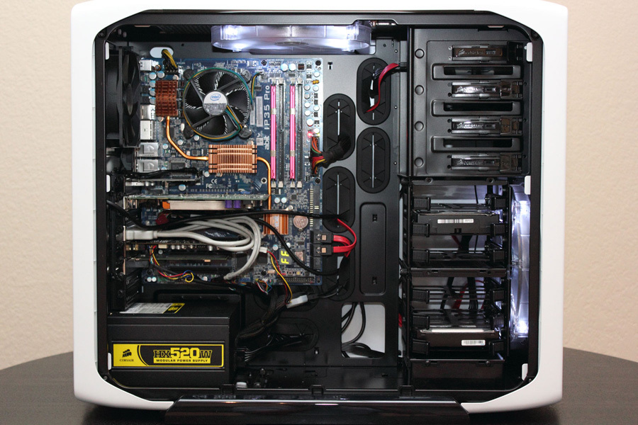
Level 1: Components Inside A Tower PC
Optical Disk Drive (e.g. DVD)
Cooling Fans
Motherboard
Hard Disk Drive
Power Supply

Slide 3
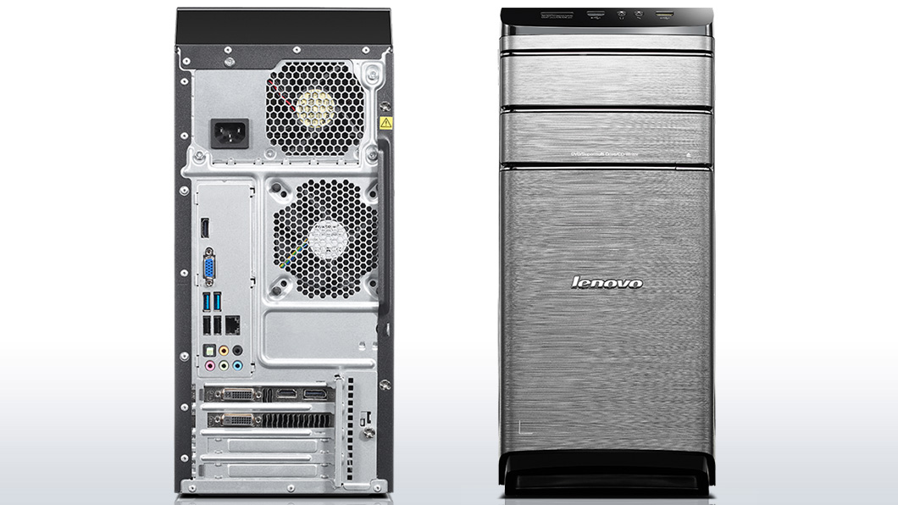
Level 1: Components Outside Of A Tower PC
USB Expansion Ports
Monitor Ports
Audio Ports
Ethernet Port

Slide 4
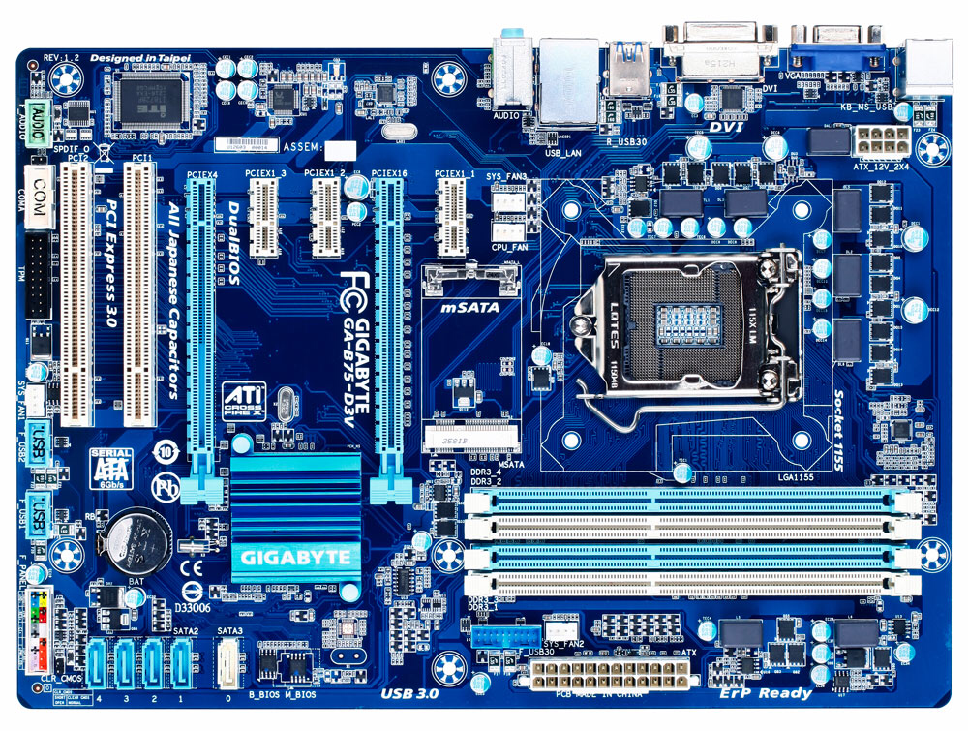
Level 2: Components Of A Motherboard
Sound Processor (Sound Card)
GPU Graphics Processor (Graphics Card)
CPU (and fan)
RAM Memory
Wi-Fi / Ethernet Interface (on-board)
Disk Drive Interface (SATA)

Slide 5
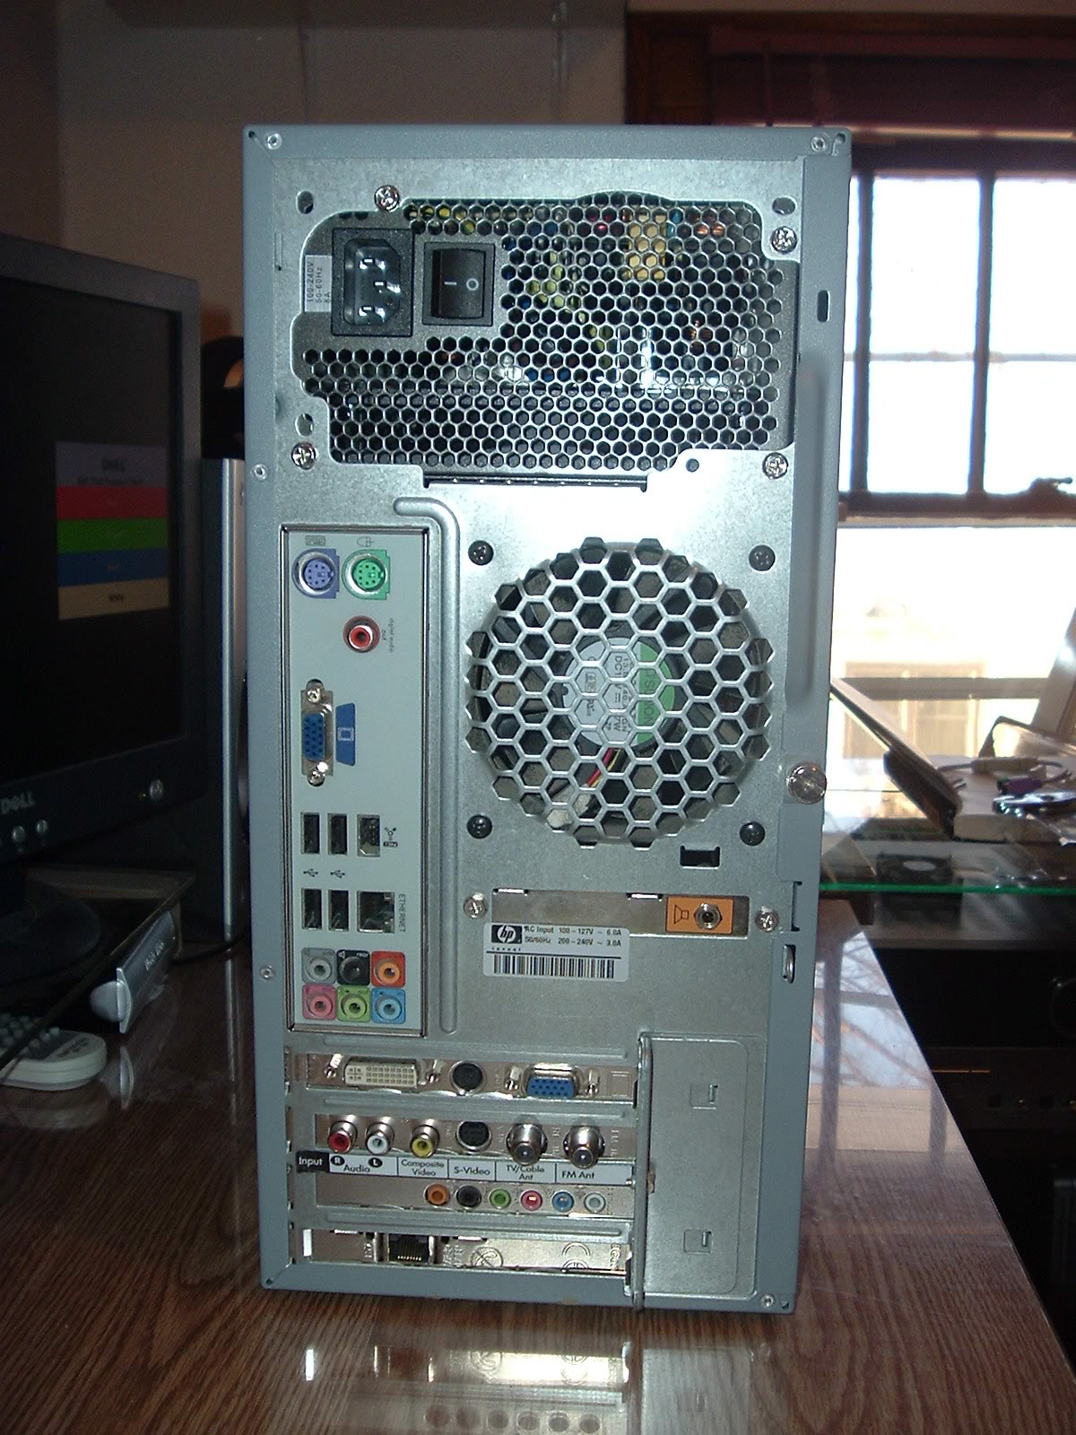
Level 3: Peripheral Devices
Power cord and power switch
Monitor Interfaces (VGA and DVI)
Mouse Interface (USB)
Keyboard Interface (USB)
USB Ports
Audio Inputs/ Outputs
Ethernet Interfaces

